Slide 1
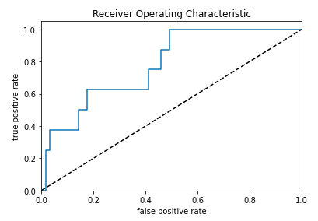
1
Hypotheses
3
Accuracy of the model
2
Business/strategic impact
H0: No relationship between the independent numerical values on the status of the owner of a loan in the bank.
H1: There is a relationship between the independent numerical values on the status of the owner of a loan in the bank.
Banks fundamental business model rely on financial intermediation by raising finance and lending (mortgage, real estate, consumer and companies loans). The latter is the major source of credit risk composed loan approval. Credit scoring in retail portfolios reflects the default risk of a customer at the moment of loan application. Machine learning models could help predict the the level of credit risk of the customer, and therefore lower the number of defauts.
4
Additional steps to improve the model:
The data was unbalanced, in order to overcome this SMOTE could be applied.
Add more data since the database was very limited.
Drop relevant columns and remove duplicates.
Apply the maximum likelihood estimation.

